Slide 1

This is project “MugiShop” an ecommerce designed for selling a wide range of products. The platform is built to provide users with an easy-to-use and secure online shopping experience. The website includes features such as search, filter, and sorting to help customers find products quickly and easily. It also provides secure payment options, including Stripe Payment,
Mustapha Bousil

Slide 2
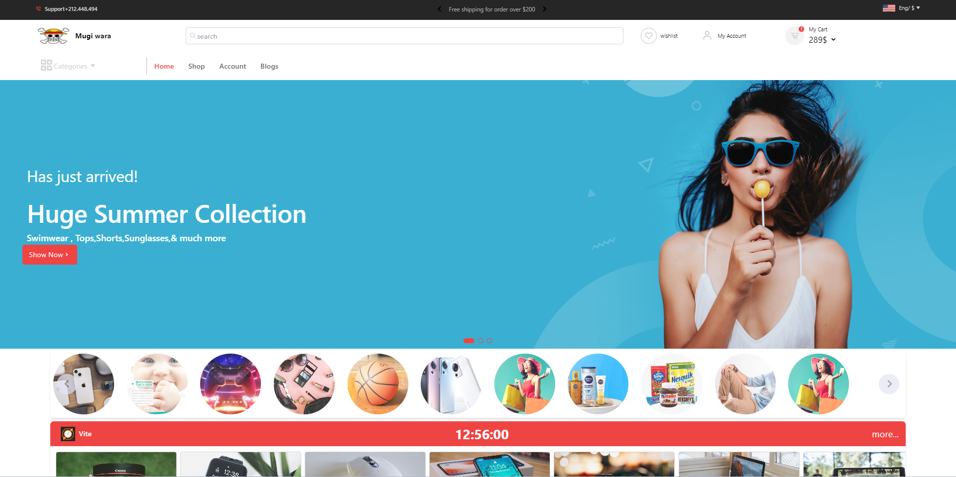

Slide 3
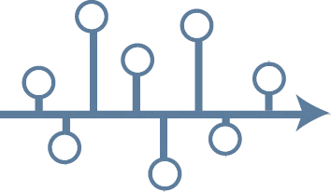
PRESENTATION PLAN
Context of the project
We will introduce the general idea behind the need for the development of such an web application
App design
Design is a key step in the development process of our application, because it not only defines the design of our application, but also and above all how it works for end users.
task planning
n this step we will define the scope of the development of our web application.
Technology
In order to achieve our objectives, we have opted for the techniques and technologies presented in this part.
Demonstration

Slide 4
Contexte général
MugiShop
"Shop with ease on our ecommerce site. We offer a wide range of products for your convenience. With online shopping, you can access our products from anywhere. We provide transparency and easy comparison to help you make informed decisions. Our project is a solution to the busy schedules and limited mobility of modern life. Come shop with us and experience the benefits of ecommerce."
As a web developer, our goal was to develop MugiShop with Laravel and Livewire.

Slide 5
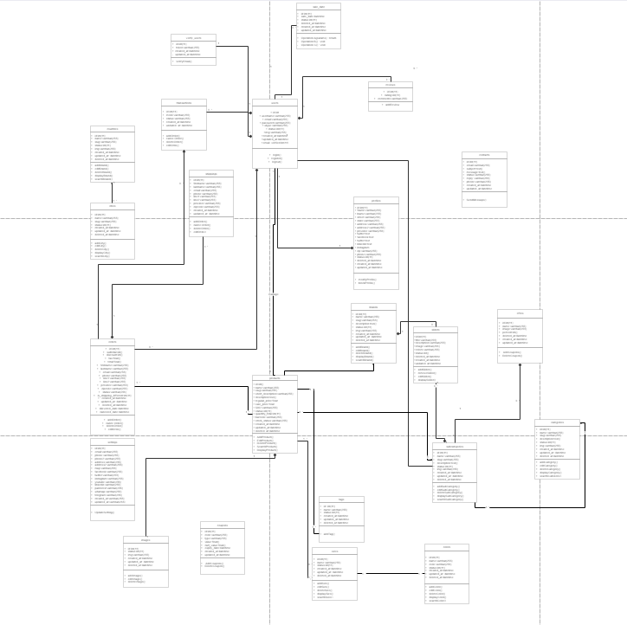
Conception
Diagramme de classes

Slide 6
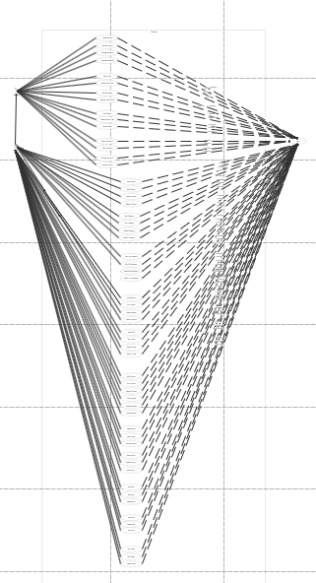
Conception

Slide 7









Slide 8
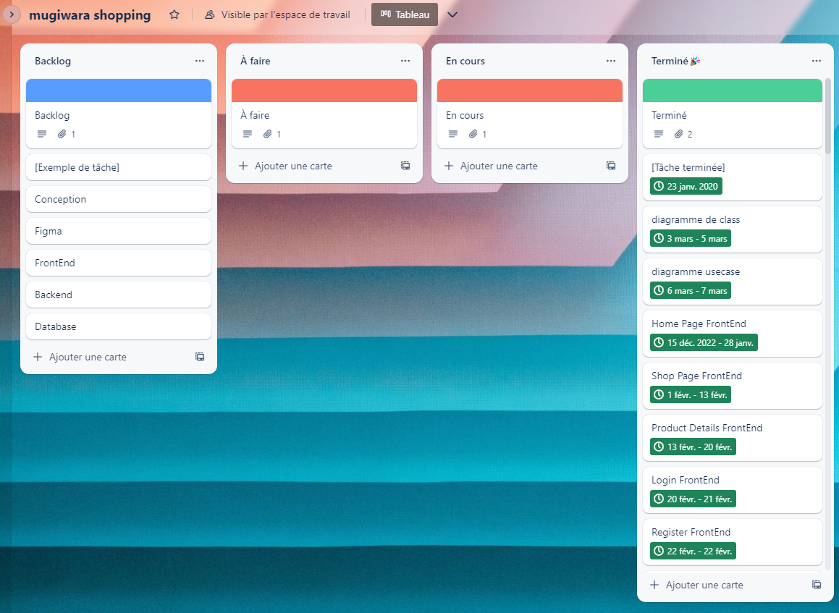
Planification des taches

Slide 9
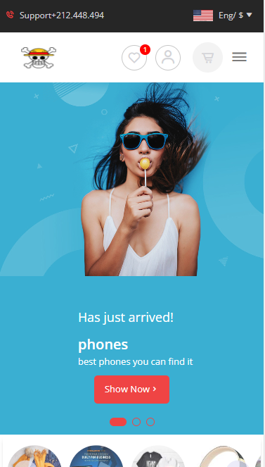
Démonstration
MUSTAPHA BOUSIL

